Slide 1
Part I: The atomic structure
The concept of the atom was improved in the past several years. The last model accepted belongs to Bohr in 1913. He postulated two important rules that contradict the classical princples, they are:
The electrons rotate around the nucleus only the orbit that following the relationship M=nh/2pi. (in which M is the angular momentum of the electron, h is the Plank’s constant and n is the integer. This mean that the angular momentum (electron-mass*speed along orbit*radius) must be a multiple of nh/2pi and that only well defined orbits are possible).
The electrons do not gain or lose energy when they remain in a given orbit, they only exchange energy when they move form one orbit to other.

Slide 2
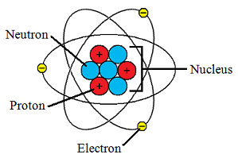
The schematic description of the atomic structure
The nucleus:
The nucleus have very high density in the atom with a diameter on the order of a few fermis, or about 10⁻⁴x the atom’s diameter. In the nucleus may be considered as made up of Z protons (they are responsible for the positive electric charge of the nucleus, their electric charge has the same absolute value as the charge of the electron, e= 1.602 x 10⁻¹⁹ C and the rest mass m_{p}= 1.672 x 10²⁷ Kg) and N neutrons. For compensate the atomic number (Z) of the atom the electrons should be presents in the atom.
N
not have electric
Charge- rest mass close to the
proton mass also

Slide 3
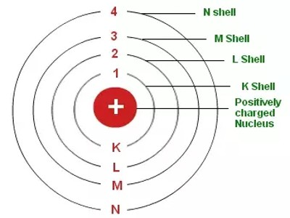
The peripheral electrons or electrons shells
Charge of the electron: e= 1.602 176 53(14) x10⁻¹⁹ C and a rest mass m_{e}= 9.109 3826(16)x10⁻³¹ kg.
The Z peripheral electrons revolve about the nucleus in well defined orbits, called Electronic (K, L, M, N) shells according to their rank
2n²

Slide 4
Important definitions
Atomic mass
  The mass of a given atom is close to the sum of the masses of the nucleons and the electrons. He actual mass of an atom X, m(X), expressed in terms of kilograms, the international unit of mass, is very small and not of much practical use.
Mass number
  It is the total number of nucleus in the atom.

Slide 5
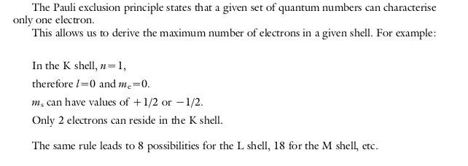
The peripheral electrons
Followed the model the peripheral electrons are characterized bu the quantum numbers:
  Principal quantum number n, defines the shell within the electron are in the atom. Corresponding 1, 2, 3, 4… as K, L, M, N shell.
  Azimuthal quantum number l, describing the electrons angular momentum and provides information about the elliptical characteristics of the orbit. l can have integer values ranging from 0 to n-1.
  Magnetic quantum number, m_{e}, represents the orientation of the electron’s magnetic moment in a magnetic field and provides information on the orbit orientation with respect to a given reference direction. The values of this quantum number, for a given orbit l, are the integer values in the range l < m_{e} < l
  Spin quantum number, m_{s} , defines the direction of the electron’s spin upon its own axis with respect to a given reference direction, and can have two values, +1/2 and -1/2.

Slide 6

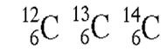

The nomenclature
Element nuclide symbol
Mass number
Atomic number
Isotones → are the atoms with the same number of neutrons, example:
Isotopes → are the atoms have the same numbers of protons Z with different numbers of neutrons
Isobars → are the atoms with the same number of nucleons (value of A). Example:

